Slide 1
AWS Simple Notification Service (SNS) Overview
Amazon Simple Notification Service (SNS) is a fully managed, pub/sub messaging and notification service provided by Amazon Web Services(AWS).
It allows you to send messages to a large number of recipients quickly and reliably.

Slide 2
Core Components
Topics
Definition: A topic is a logical access point that groups multiple endpoints for message delivery. Think of it as a channel where messages are sent.
Purpose: Topics allow you to manage and categorize messages and subscribers efficiently.
Usage: You create a topic and publish messages to it. The topic then forwards these messages to all its subscribed endpoints

Slide 3
Subscriptions
Definition: Subscriptions are endpoints that receive messages sent to a topic. They can be various types, including email addresses, SMS numbers, HTTP/S endpoints, AWS lambda functions , and Amazon SQS queues.
Types:
Email: Sends messages as emails.
SMS: Sends text messages to mobile devices.
HTTP/S:Sends messages to a web server via HTTP/Send points.
Lambda: Invokes an AWS Lambda function with the message.
SQS: Sends messages to an Amazon Simple Queue Service(SQS) queue for further processing

Slide 4
Publish/Subscribe Model
Publishing: Applications or services publish messages to a topic.
Subscribing :Subscribers register their endpoints to receive messages from the topic.
Delivery: SNS delivers the published messages to all subscribed endpoints.

Slide 5
Key Features
Scalability
Automatically scales to handle a large volume of messages and subscribers without requiring manual intervention.
Message Filtering
Allows you to filter messages based on attributes, enabling targeted delivery to subscribers.
High Availability
Built on AWS's infrastructure , providing high availability and reliability.
Durability
Messages are stored redundantly across multiple servers and data centers to ensure durability.
Cost-Effectiveness
Pay-as-you-go pricing model based on the number of messages published and delivered, without up front costs.

Slide 6
How SNS Works
Create a Topic :
Use the AWS Management Console , AWS CLI , or AWS SDKs to create a new topic. Assign a name and optionally configure attributes like access policies.
Subscribe Endpoints:
Add subscriptions to the topic by specifying the protocol and endpoint (e.g., email address, phone number, URL, Lambda function).
Publish Messages:
Send messages to the topic using the AWS Management Console , AWS CLI, or programmatically through AWS SDKs. The message is then distributed to all the topic’s subscribers.
Manage Notifications:
Monitor and manage notifications using CloudWatch
Metrics and logs to track message delivery, subscription status, and more

Slide 7
Use Cases
Application Alerts
Notify administrator or Users of system health issues , application errors, or performance metrics.
User Notifications
Send updates , promotional messages , or reminders directly to users via email, SMS, or push notifications.
Event-Driven Architectures
Integrate with other AWS services(e . g., triggering AWS Lambda functions or processing messages in an SQS queue) to build event-driven applications.
System Monitoring
Monitor infrastructure and applications by sending alerts based on system events or thresholds.

Slide 8
Advantages
Ease of Use
Simplifies the process of sending notifications and managing message distribution.
Integration with AWS Services
Seamlessly integrates with other AWS services like Lambda , SQS , and CloudWatch .
Security
Supports encryption and access control policies to secure messages and manage access.

Slide 9
Example Workflow
Create a Topic:
Example: "Order Updates"
Subscribe Endpoints:
Email :user@example.com
SMS:+1234567890
Lambda Function : Process Order Update Function
Publisha Message:
Example Message:"Yourorder#12345hasbeenshipped."
Message Distribution:
SNS sends the message to user@example.com, +1234567890 ,and invokes the Process Order Update Function Lambda function.

Slide 10
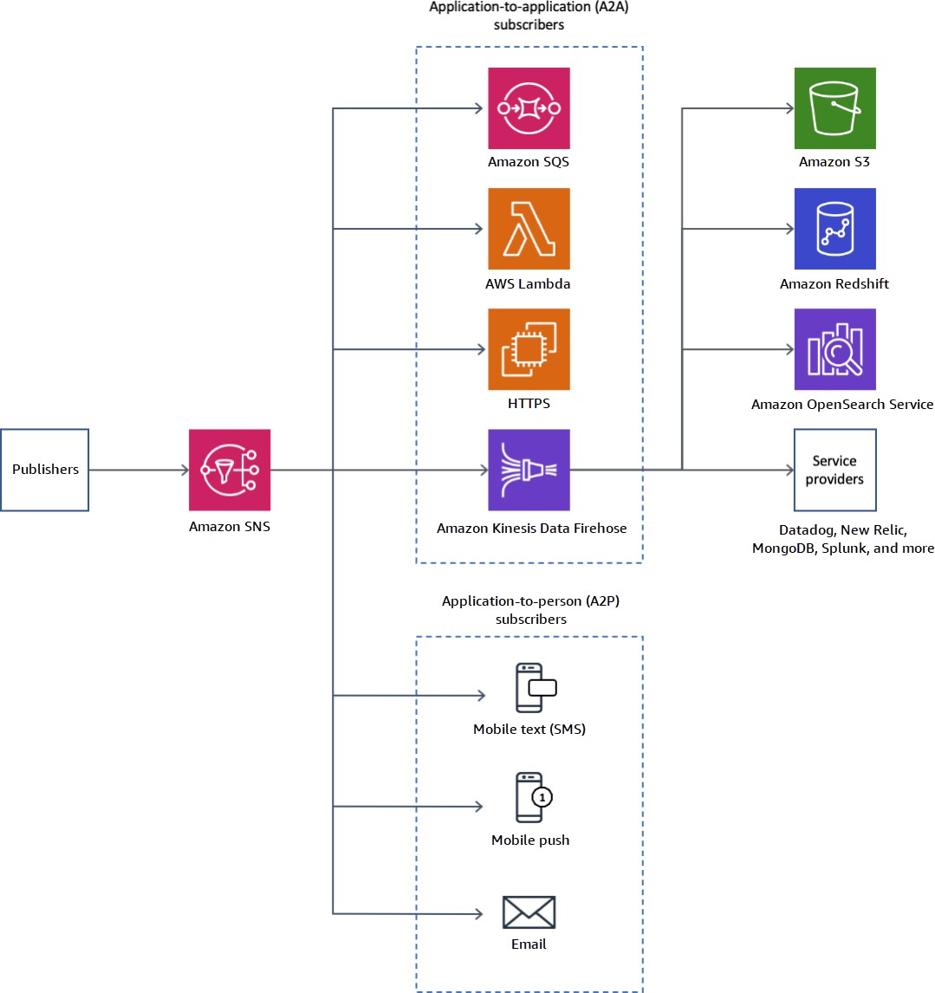

Slide 11
A2A(Application-to-Application) Definition:
A2A communication involves messages send from one application another . It is primarily used to enable communication between different services or components within an application's architecture.

Slide 12
UseCases:
Event Notifications : An application publishes events or status updates to a topic, which other applications or micro services subscribe to for processing. For example , an e-commerce platform might publish order status updates to an SNS topic, which other services (like inventory management or shipping) can then process.
System Integration: Different applications or micro services communicate with each other through SNS , allowing for decoupled and scalable architectures. This can be useful in service-oriented or event-driven architectures where components need to exchange information asynchronously.
Example:
A web application publishes a message about a user registration event to an SNS topic. An analytics service subscribed to the topic receives the message and updates the user statistics database.

Slide 13
A2P(Application-to-Person) Definition:
A2P communication refers to messages sent from an application to an individual person. This typically involves notifications or alerts delivered directly to end-users , often via channels like SMS , email , or push notifications.
Use Cases:
User Notifications : Sending important alerts or updates to users , such as password reset instructions, appointment reminders, or promotional offers.
Transactional Alerts: Notifying users about specific transactions or actions , like order confirmations , shipping updates , oraccount activity.
Example:
An online retail application sends an SMS notification to a customer informing them that their order has been shipped . Another example is sending an email alert to a user when their password is successfully changed.

